Slide 1
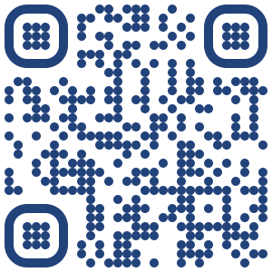
Understanding variability in response to therapy across patients with colorectal cancer metastasizing to liver
Adam Wojtulewski
Moffitt Cancer Center
Machine Learning Department
Karolak Lab

Slide 2
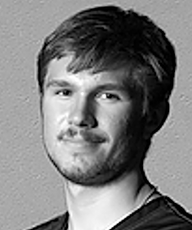
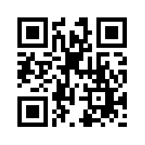
About me
Adam Wojtulewski
Completed International Baccalaureate (IB) Program at Palm Harbor University High School in May 2021
Third year undergraduate at the University of Florida (UF); graduate December 2024
Major in Computer Science and Minor in Artificial Intelligence
President of the Polish Student Association (POLSA) at UF
Took this internship opportunity to have a hands-on application of machine learning approaches
LinkedIn QR Code

Slide 3
Understanding the problem
Colorectal cancer (CRC) is the second leading cause of cancer related mortality in men and women combined
Patients with metastatic CRC (mCRC) have an very poor survival rate of as low as 14% at 5-years
Of which, liver metastases account for a large portion of the deaths
Effective chemotherapy agents and novel systemic therapies improve these numbers
However, there is a high inter- and intra-tumoral heterogeneity
Moreover, patients with similar mCRC features still respond differently to treatment

Slide 4
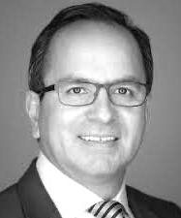
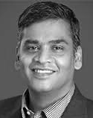
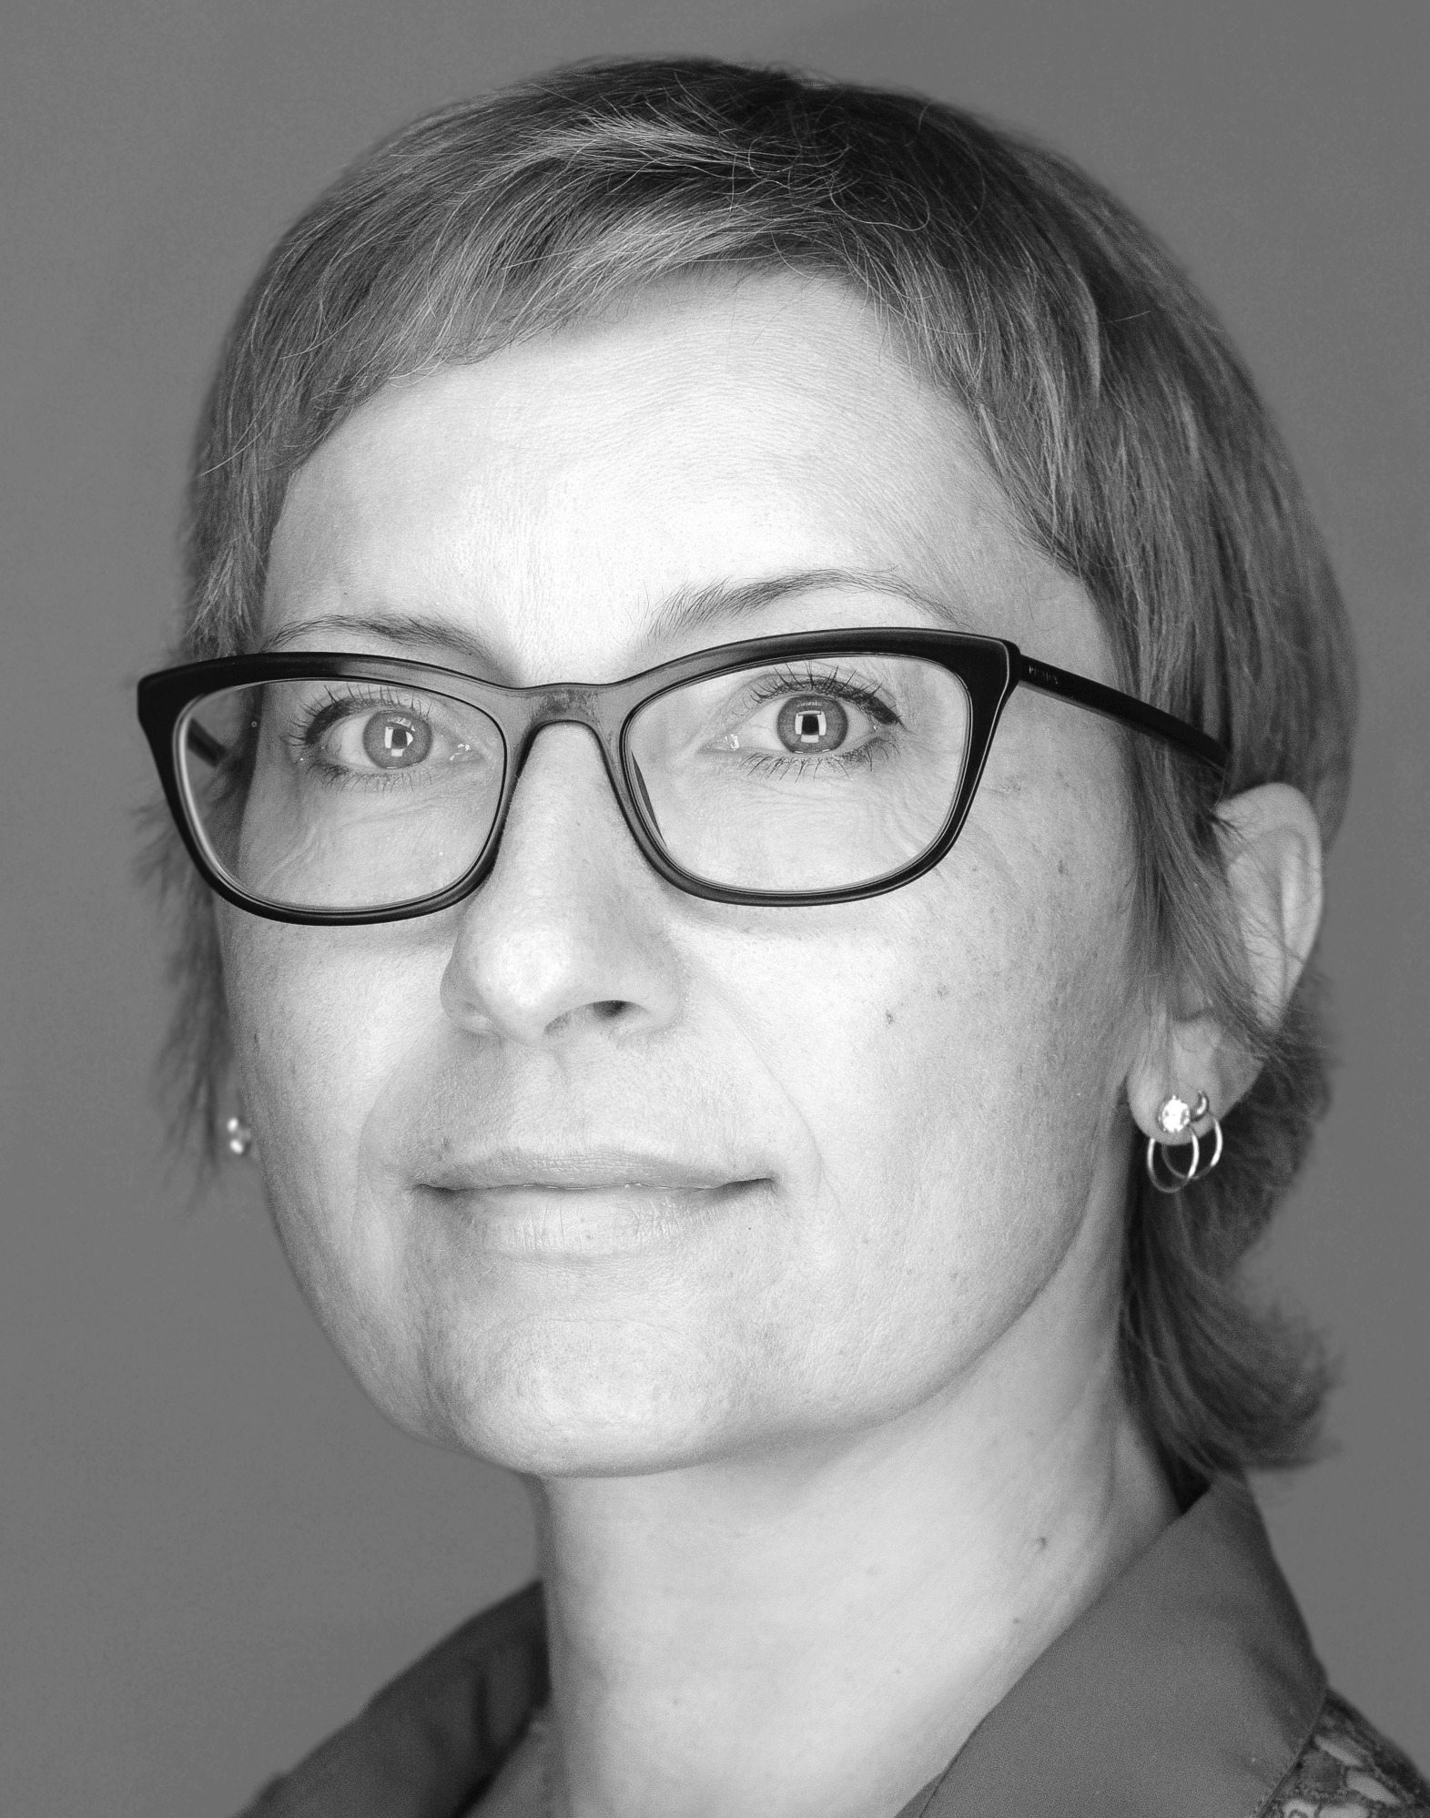
What needs to be researched
There is an urgent need to understand the variability in response to therapy across patients with similar cancer features
Can we predict response to therapy by integrating clinical, morphologic, and molecular factors (collaboration: Anaya, Balagurunathan, and Karolak)
The goal of this study is to take the first step and understand the variability in response using public sequencing data

Slide 5
Materials and methods
Datasets
Data Pre-processing
Data visualization
K-Means Clustering
Random Forest Classifier
Artificial Neural Networks (Deep Learning)
Model verification

Slide 6
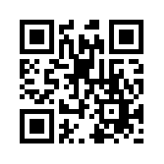

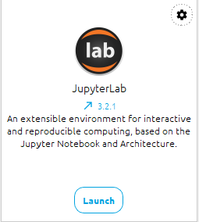
Pre-requisites to use my code
Integrated Development Environments (IDEs)
Github QR Code
https://github.com/AdamWojtul28/Moffitt-Data-Analysis

Slide 7
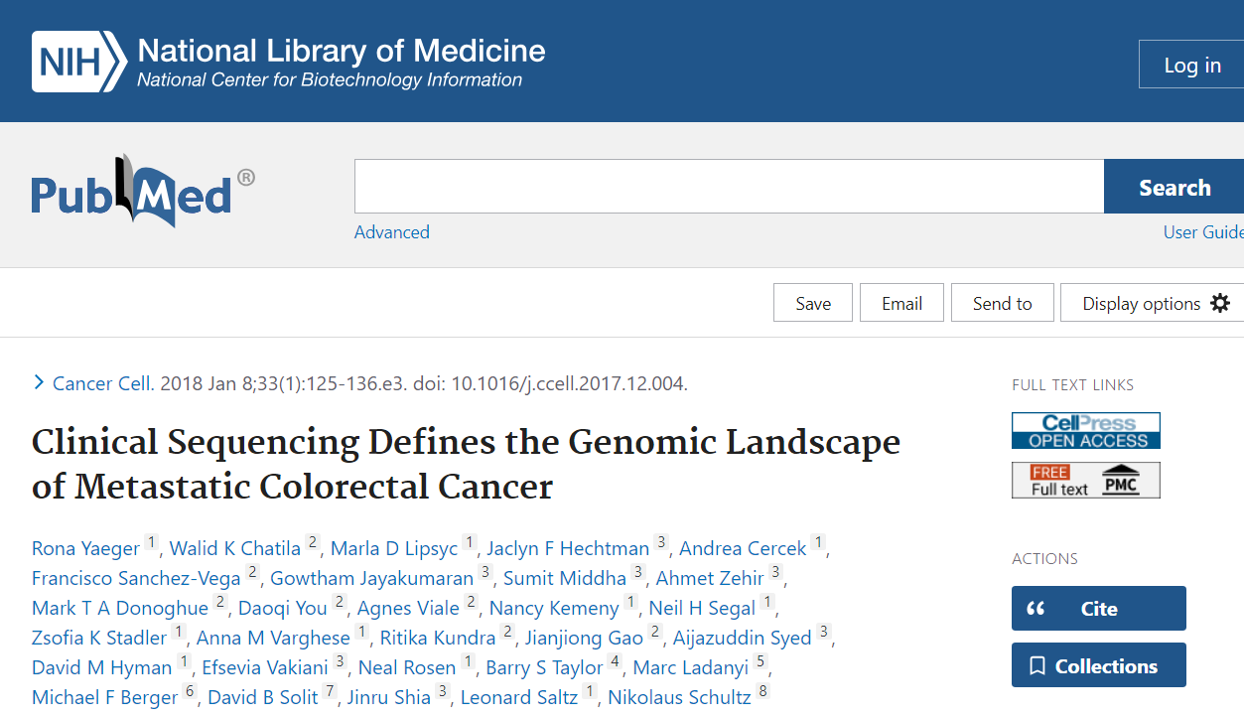
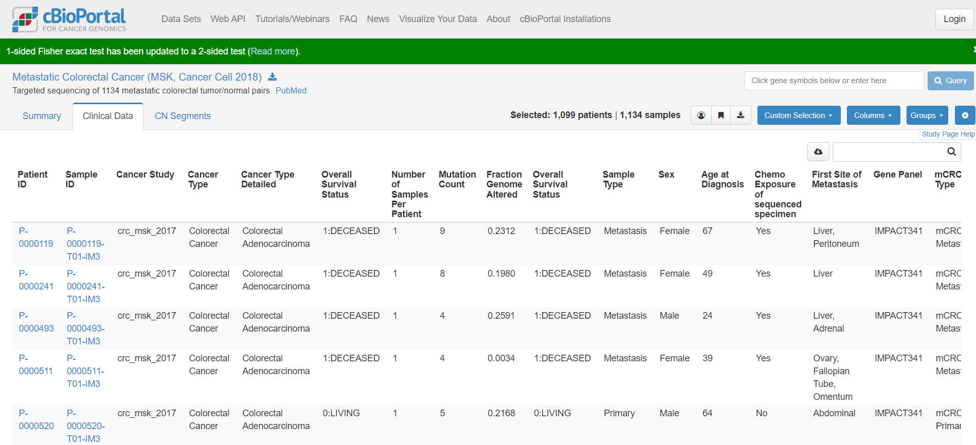
Datasets

Slide 8
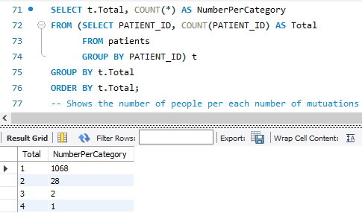
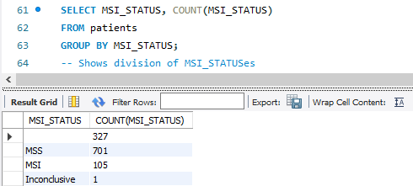
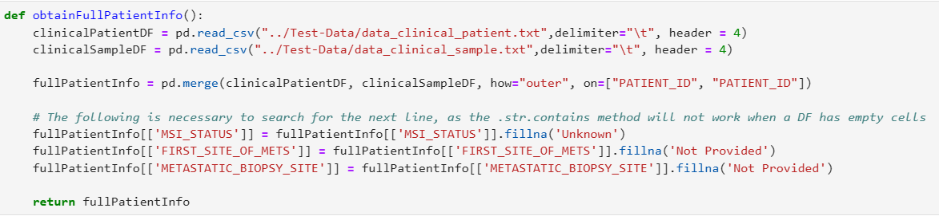

Data Pre-processing (Part 1)
Understanding the datasets
Deciding which tables to use
Deciding which columns to use
Merging data tables
Eliminating blank cells

Slide 9
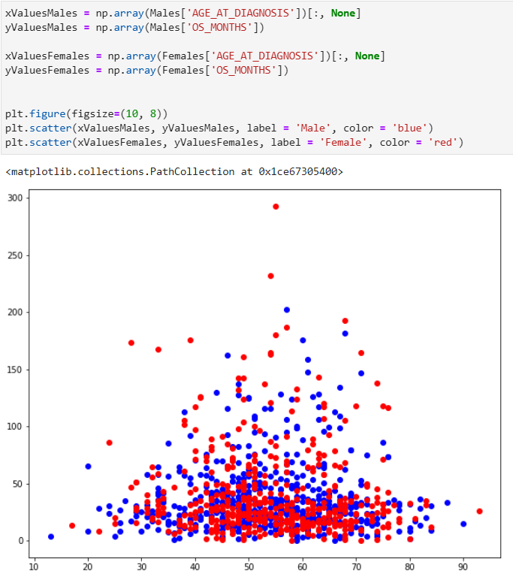
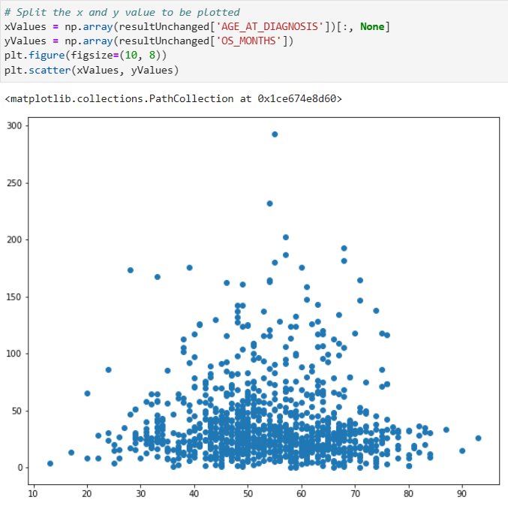
Data visualization: Pyplot
Basic form of visualization
Used to potentially visualize general trends on the entire dataset as a whole
Manually split dataset according to desired needs

Slide 10
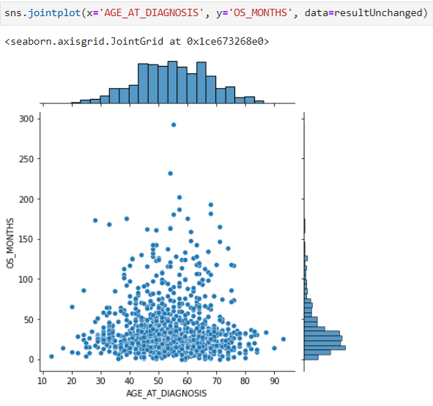
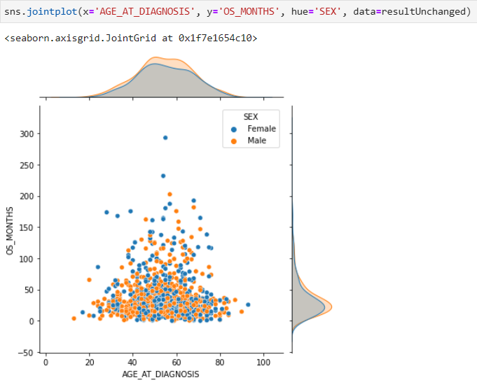
Data visualization: Seaborn
More advanced form of visualization
Used to create more complex graph types
Dataset can be split using the parameters in the graph
Eliminates need for manually splitting data

Slide 11
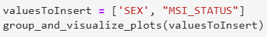
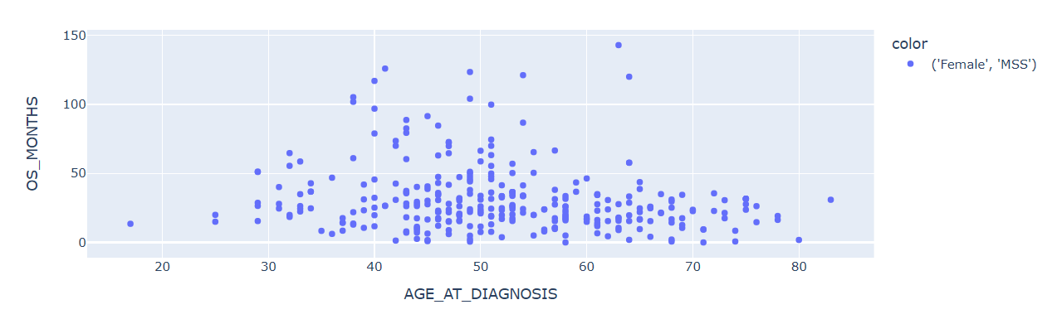
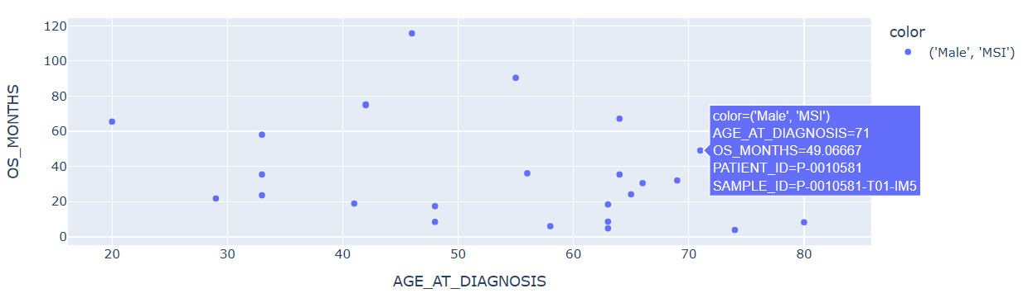
Data visualization: Plotly
Previous 2 approaches have drawbacks:
Neither produces interactive plots
To much data
Function that incorporates Plotly:
Splits data according to parameters
Produces interactive plots for each group

Slide 12
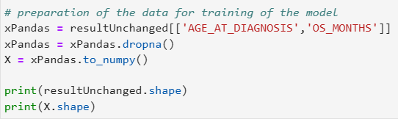
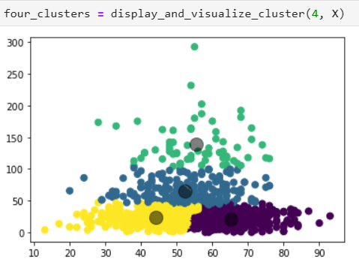
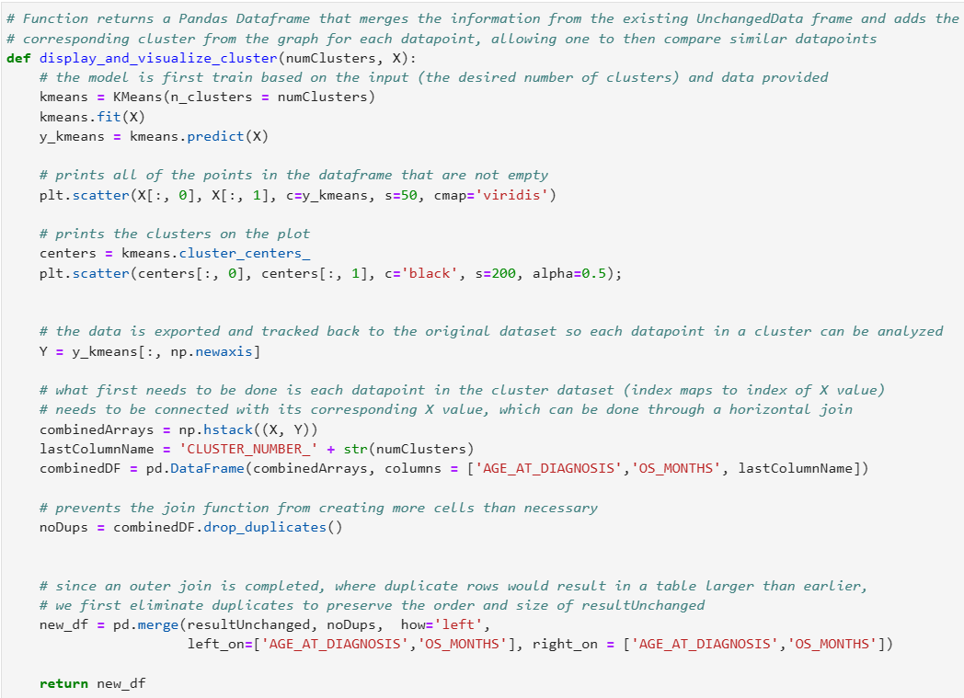
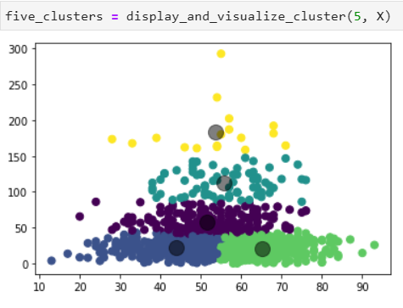
K-Means Clustering

Slide 13
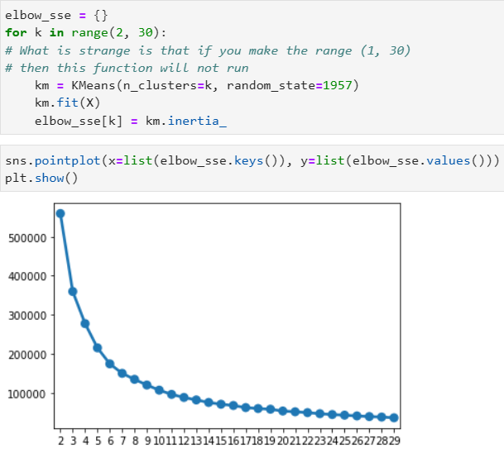
K-Means Clustering
Function developed appends cluster number to original dataset
The patients in each cluster can be compared for similar traits
Combining this function with elbow plot (right) can suggest proper number of clusters to use
Would yield more significant results to this approach

Slide 14
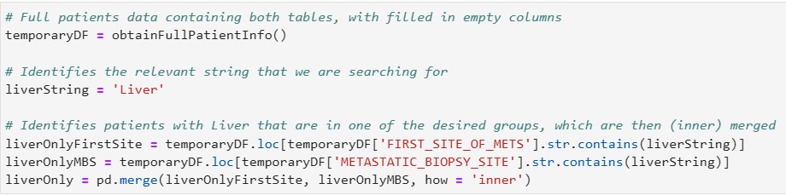
Data Pre-processing (Part 2)
Isolating only Liver MS patients
Filling empty values
One-Hot Encoding string columns
Creating training and testing data

Slide 15
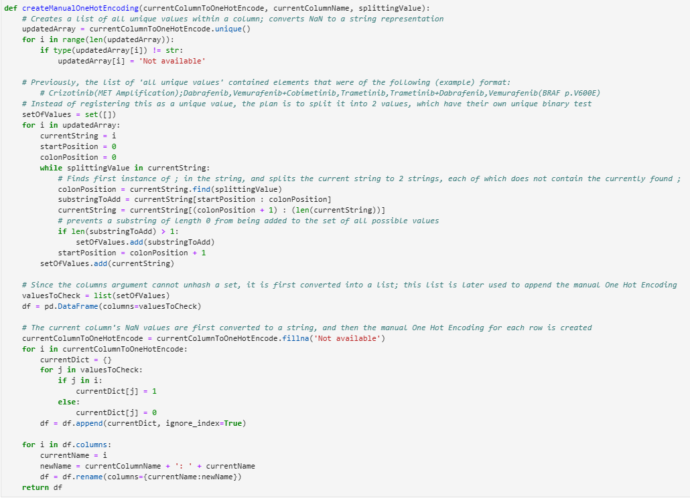
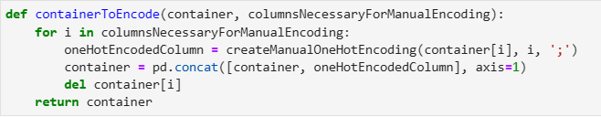
Data Pre-processing (Part 2)
Outliers/anomalies in data:
Character delimited cells
Would result in inaccurate One-Hot Encoding

Slide 16
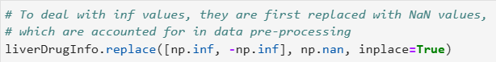
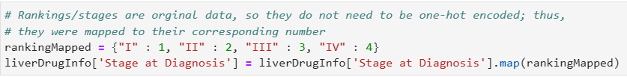
Data Pre-processing (Part 2)
Outliers/anomalies in data:
Infinity values
Would result in an array of NaN for ANN output
Ordinal data or binary mappings
Stage at Diagnosis
Roman Numerals
Vital Status
2 separate columns that could be concatenated to 1

Slide 17
Random Forest Classifier

Slide 18
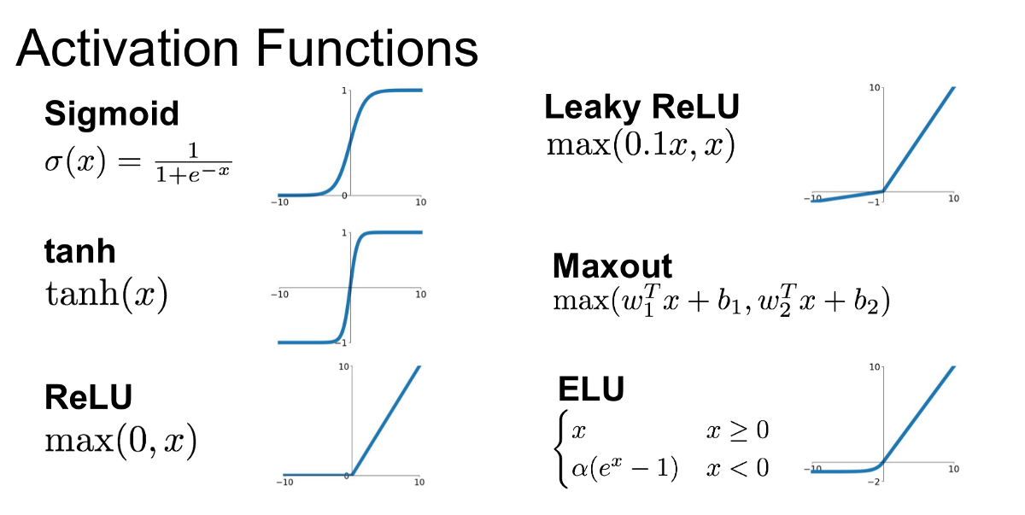
How Neural Networks Work

Slide 19
Artificial Neural Networks (Deep Learning)

Slide 20
Model verification

Slide 22
Future areas of exploration
Additional verification methods for models developed
F1 Score, AUC-ROC, varying threshold
Transfer learning to Moffitt Data
Development of a self-learning interface to support clinical decision making

Slide 23
Acknowledgements
This internship would not be possible without three main groups:
Family
Machine Learning Department, especially Doctor Karolak and my team members
Moffitt Cancer Center as a whole

Slide 24
Thank you
Github QR Code
LinkedIn QR Code
Questions?

Slide 25
Sources Consulted
https://www.cancer.gov/publications/dictionaries/cancer-terms/def/metastasis
https://bjssjournals.onlinelibrary.wiley.com/doi/10.1002/bjs5.50341#:~:text=Metachronous%20metastasis%20was%20defined%20as,mm%20of%20the%20resection%20margin.
https://www.ncbi.nlm.nih.gov/pmc/articles/PMC3349572/#:~:text=%22Synchronous%20metastasis%22%20and%20%22synchronous,of%20the%20primary%20colon%20cancer.

